Slide 1
Dynamic Templates using Django Template Django
Dr. Navneet Kaur

Slide 2
Django Template Language
Django Template Language (DTL) is a special code that you can put into your HTML files to make them dynamic.
It allows you to add things like variables, loops, and conditionals to your web pages, so they can change based on different conditions or data.

Slide 3
Template Tags
Django templates use template tags, which are enclosed within {% %}, to execute logic, such as loops, conditionals, including other templates, etc.

Slide 4
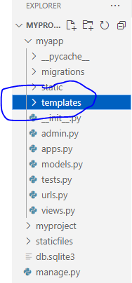
Prerequisites
You need to create a folder named templates in your myapp

Slide 5
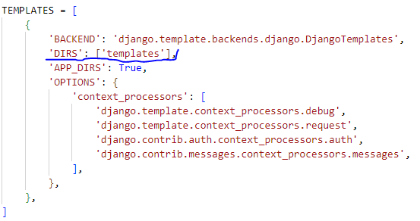
Prerequisites
Open settings.py of your myapp and then make the following change in the TEMPLATES list:

Slide 6
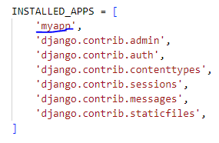
Prerequisites
Inside settings.py, there is another list called INSTALLED_APPS and make the following changes:

Slide 7
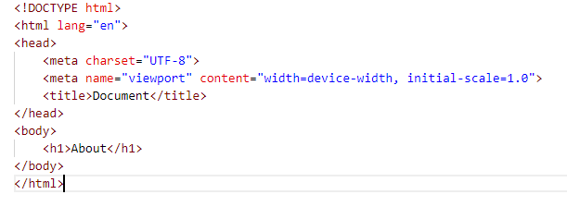
How to render simple template?
Step1: Create a file named contact.html in templates folder
Contact.html

Slide 8

How to render simple template?
Step2: Open views.py inside myapp
views.py

Slide 9

How to render simple template?
Step3: Open urls.py inside myapp
urls.py

Slide 10
Working with variables, loops and if statements
restro.html
<!DOCTYPE html>
<html lang="en">
<head>
<style>
.free{
background-color: aquamarine;
}
</style>
</head>
<body>

Slide 11
Working with variables, loops and if statements
<table border="1">
<tr><th>Name</th><th>Cost</th></tr>
{% for items in menuitems %}
{%if items.cost == 'free'%}
<tr class="free">
<td>{{items.name}}</td>
<td>{{items.cost}}</td>
</tr>
{% else %}
<tr>
<td>{{items.name}}</td>
<td>{{items.cost}}</td>
</tr>
{% endif %}
{% endfor %}
</table>
</body>
</html>

Slide 12
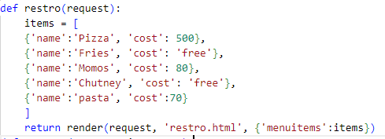
Working with variables, loops and if statements
views.py

Slide 13
Working with variables, loops and if statements
urls.py

